Slide 1

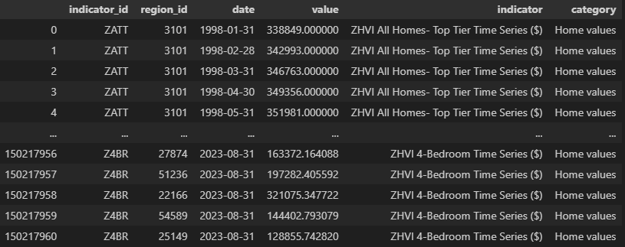
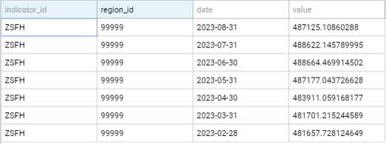
Nasdaq Real Estate Data Cleaning
Project 1 – Ashli ben, lovepreet singh, omar salloum, alexandru arnautu.

Slide 2
In this project, we’ve gathered Real Estate data from Nasdaq and cleaned it to show linear regression of the Average price of all homes, and condos for a Real Estate tycoon.

Slide 3
The Real Estate tycoon has also invested in a Freight shipping company and is looking to set up near the four main coasts in the states, so we’ve provided data from Washington, New York, Florida and California.

Slide 4
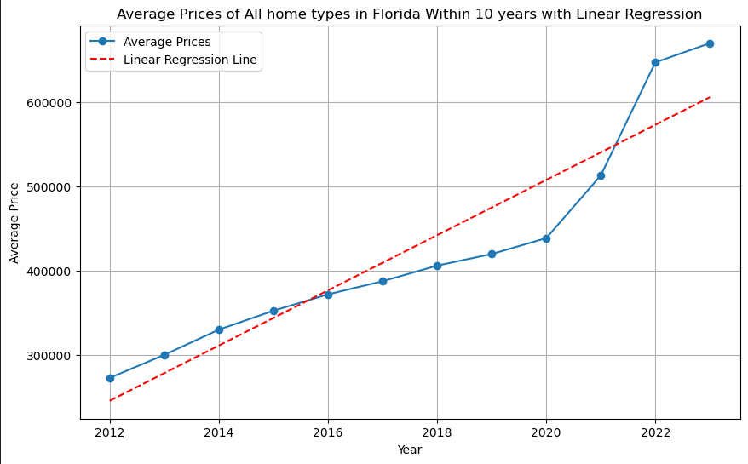
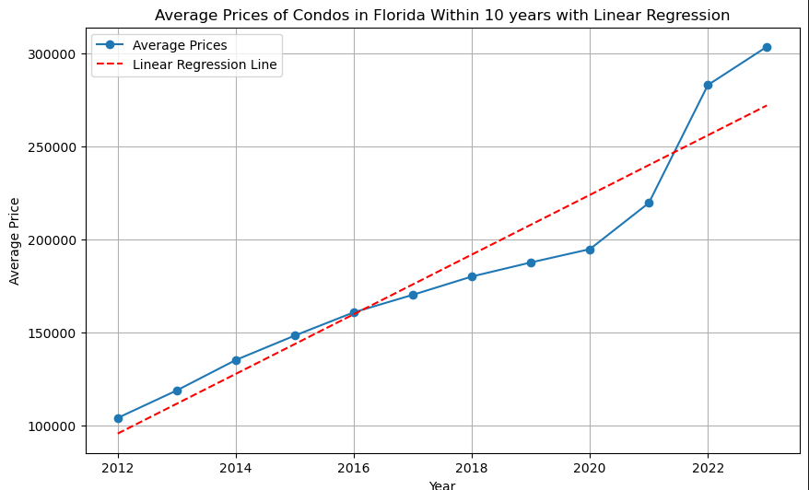


Here we can see that in the state of Florida, the average prices of all homes and Condos have tripled in the past 10 years. The Linear Regression shows a steady slope making Florida a great place to invest near the coast, even though our Standard deviation is high due to discrepancies of unfavorable neighborhoods, the information is good.

Slide 5
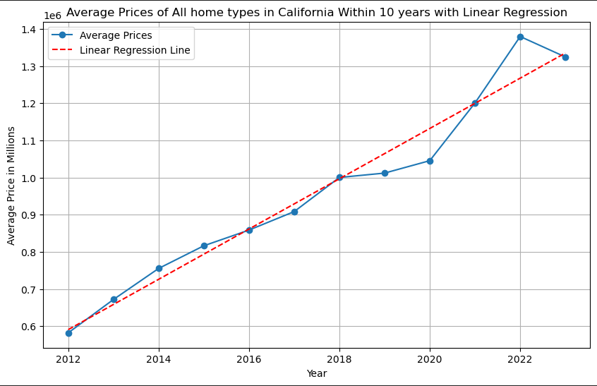
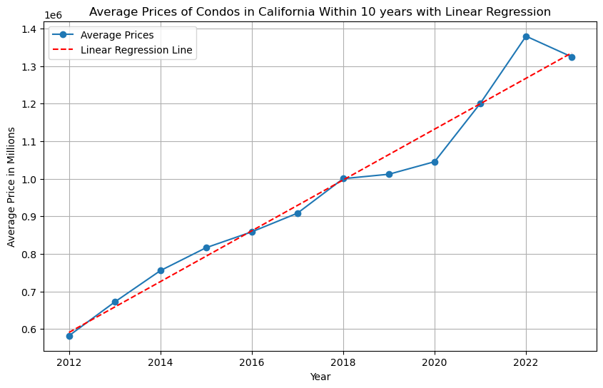








Here we can see that in the state of California, the average prices of all homes and Condos have more than doubled in the past 10 years. The average prices of all homes and Condos are also worth more compared to other States near the coasts of America. The Linear Regression shows a steady slope making California a great place to invest near the coast, even though our Standard deviation is high due to major discrepancies of unfavorable neighborhoods, the information is good.

Slide 6
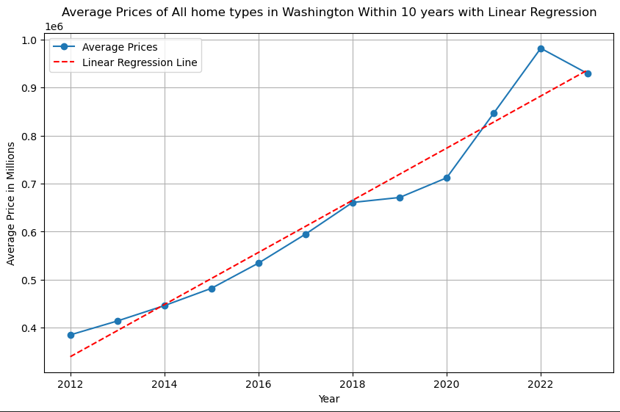
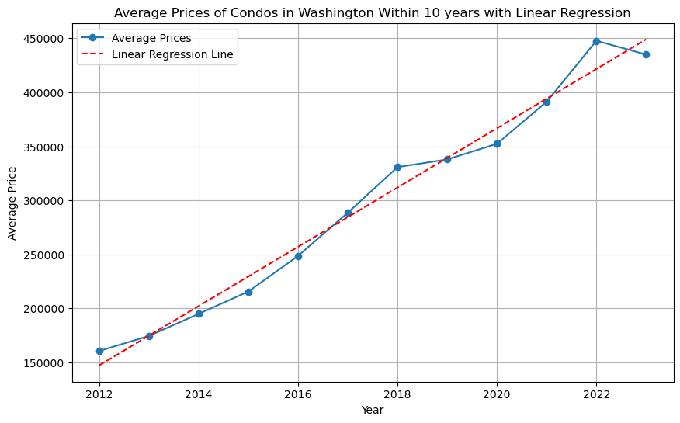


Here we can see that in the state of Washington, the average prices of all homes and Condos have almost tripled in the past 10 years. The average prices of all homes are also worth more compared to other States near the coasts of America. The Linear Regression shows a steady slope making Washington a great place to invest near the coast, even though our Standard deviation is high due to minor discrepancies of unfavorable neighborhoods, the information is good.

Slide 7
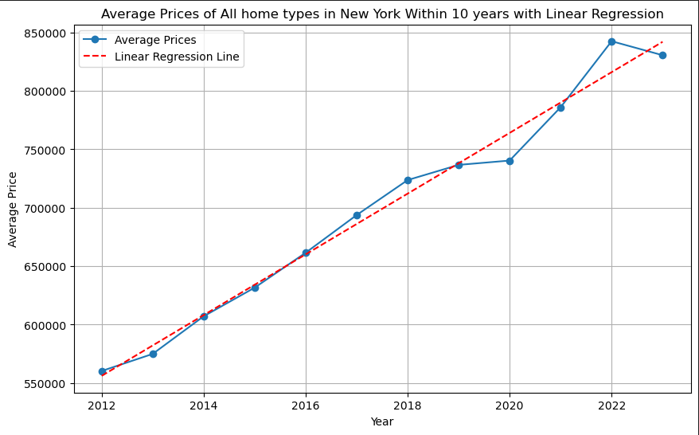
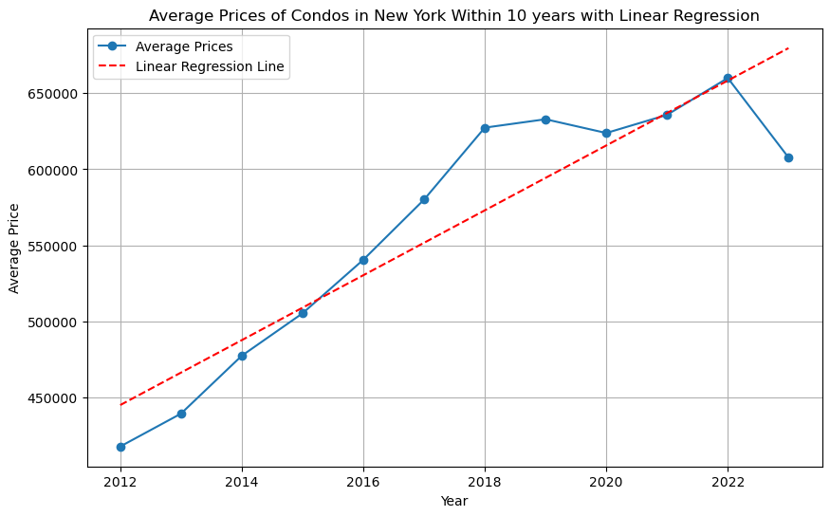


Here we can see that in the state of New York, the average prices of all homes and Condos have almost doubled in the past 10 years. The average prices of all homes are within the average compared to other States on the coasts of America. The Linear Regression shows a steady slope making Washington a great place to invest near the coast, even though our Standard deviation is high due to discrepancies of unfavorable neighborhoods, the information is good.

Slide 8
After looking at all the data, we’ve come to conclusion that the state of California has the highest Value, and greatest Linear Regression slope of property value increase in the last ten years, making it the ideal state to invest in Real Estate.

Slide 9
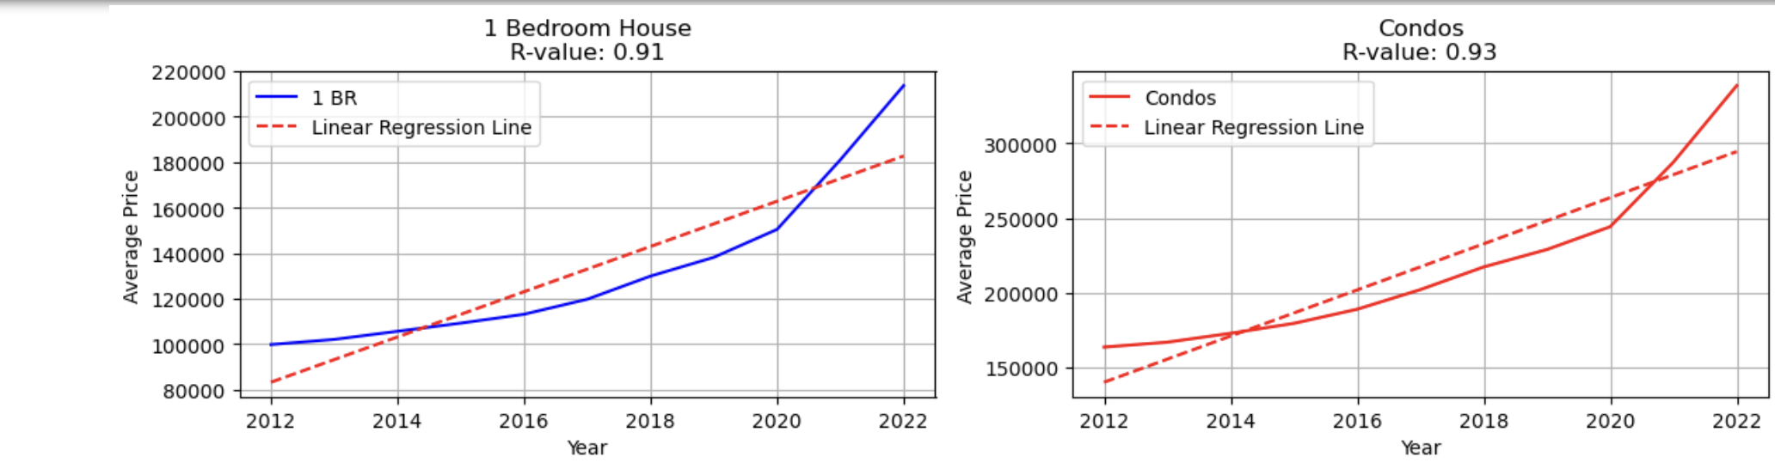
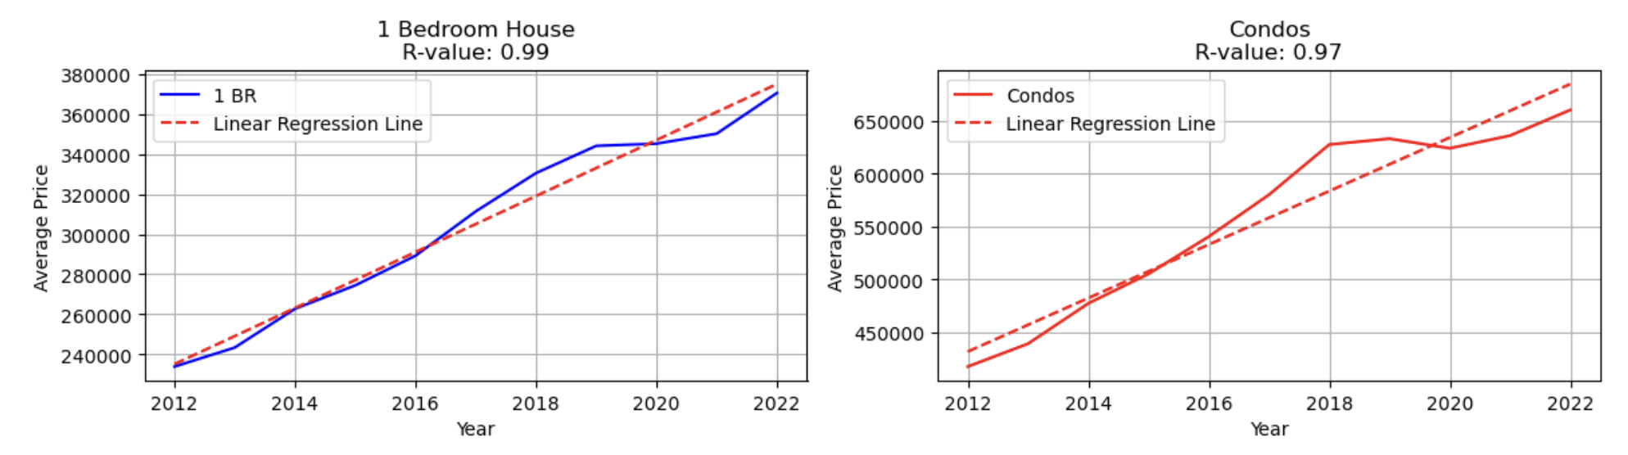
New Hampshire: 1 Bedroom and Condos (2012-2022)
Maine: 1 Bedroom and Condos (2012-2022)

Slide 10
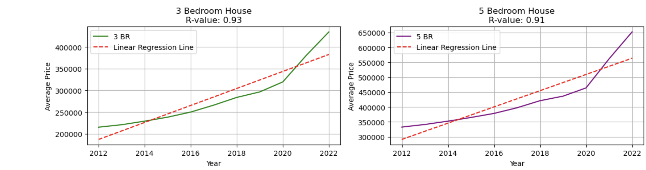
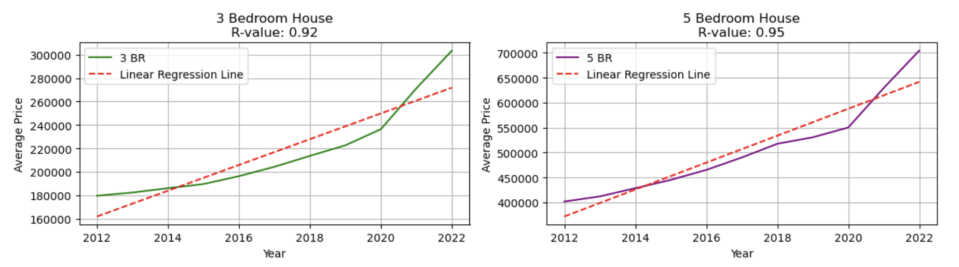
New Hampshire: 3 Bedroom and 5+ Bedroom (2012-2022)
Maine: 3 Bedroom and 5+ Bedroom (2012-2022)

Slide 11
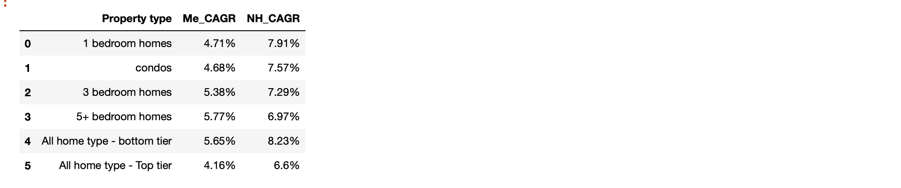
CAGR : Maine Vs New Hampshire (2012-2022)
New Hampshire indicates the higher Compound Annual Growth Rate when compared with Maine in all the property types in given years.

Slide 12
Analysis of both the States(Maine and New Hampshire), we have concluded that both the states indicated the strong positive relationship between price and year. CAGR is higher for New Hampshire, when compared.

